Slide 1
BBC News Article Sorting
By - Rushikesh Darge

Slide 2
Objective:
Development of a predictive model that takes a news as an input and in output it returns the category of that news. Model correctly tells us the given news from which category.
Benefits:
Time reduce to sorting news
Reduce human error
Task is automated

Slide 3
Data Sharing Agreement :
Dataset file name : BBC News Train.csv
Number of Columns : 3
Column names : ArticleId, Text, Category
Column data type : int, string, string

Slide 4
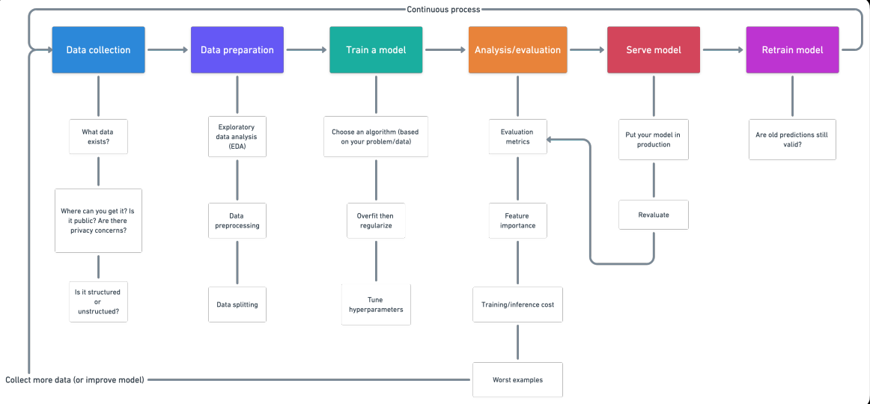

Slide 5
Data Validation and Data Transformation :
Data : We download the csv files form kaggle platform for training
Data Preprocessing : See samples of rows and get insight of data. Some contain different forms of the same words like good, better, best or do, doing like words. We prepreocess them and also we remove all characters except alphabets and numbers.
Null values in the columns : We don't have any null values in our dataset

Slide 6
Model Selection:
After the PCA visualization , we find the best model out of these 2 algorithms “Logistic Regression” and "Decision Tree". We calculate the Accuracy and F1 scores for both models and select the model with the best score.

Slide 7
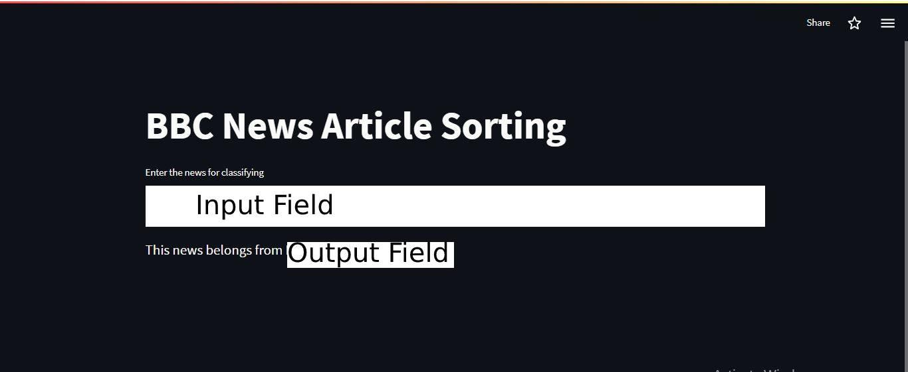
Deployment:

Slide 8
Thank You!!!

